Slide 1

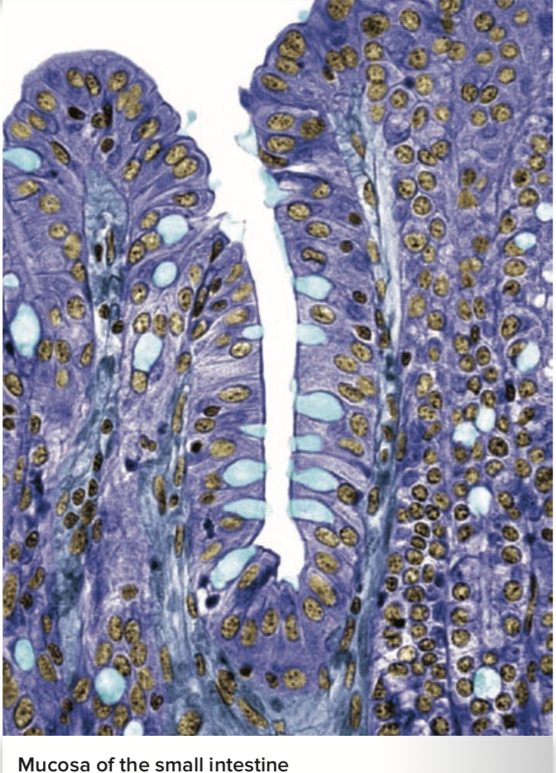
The Digestive System
Al-Farabi Kazakh National University
Higher School of Medicine
The Stomach. Liver, gallblader, pancreas
Copyright © The McGraw-Hill Companies, Inc. Permission required for reproduction or display. Figure from: Saladin, Anatomy & Physiology, McGraw Hill, 2018

Slide 2
LEARNING OUTCOMES
As a result of the lesson you will be able to:
describe the gross and microscopic anatomy of the stomach;
state the function of each type of epithelial cell in the gastric mucosa;
identify the secretions of the stomach and state their functions;
explain how the stomach produces hydrochloric acid and pepsin;
describe the contractile responses of the stomach to food;
describe the three phases of gastric function and how gastric activity is activated and inhibited.
describe the gross and microscopic anatomy of the liver, gallbladder, bile duct system, and pancreas;
describe the digestive secretions and functions of the liver, gallbladder, and pancreas;
explain how hormones regulate secretion by the liver and pancreas.
Al-Farabi Kazakh National University
Higher School of Medicine

Slide 3
Medical terms
chyme [juice ] – an acidic, soupy or pasty mixture of semidigested food , most digestion occurs after the chyme passes on to the small intestine
antrum [cavity] –a funnel-like part of the pyloric part of stomach.
pylorus [gatekeeper]– latter terminates of the stomach which is a a narrow passage into the duodenum.
gastric rugae [folds, creases]– conspicuous longitudinal wrinkles
Al-Farabi Kazakh National University
Higher School of Medicine

Slide 4
Stomach
Location-upper left abdominal cavity immediately inferior to the diaphragm
lesser and greater curvatures
functions - food storage organ, mechanically breaks up food particles, liquefies the food, and begins chemical digestion of protein and fat

Slide 5
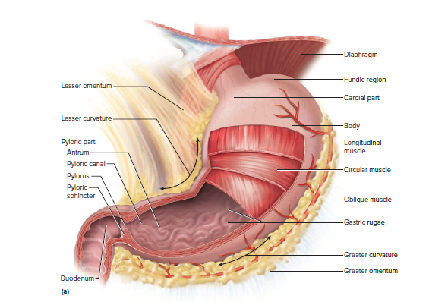
Gross Anatomy of Stomach
Copyright © The McGraw-Hill Companies, Inc. Permission required for reproduction or display. Figure from: Saladin, Anatomy & Physiology, McGraw Hill, 2018

Slide 6

Gross Anatomy of Stomach
  Four regions
    cardiac region (cardia)
    fundic region (fundus)
    body (corpus)
    pyloric region
    subdivided into the funnel-like antrum
      pyloric canal
      pylorus
  pyloric (gastroduodenal) sphincter
Describe the structures and function

Slide 7
Innervation
  parasympathetic fibers from vagus
  sympathetic fibers from celiac ganglia
Circulation
supplied with blood by branches of the celiac trunk
all blood drained from stomach and intestines enters hepatic portal circulation and is filtered through liver before returning to heart

Slide 8
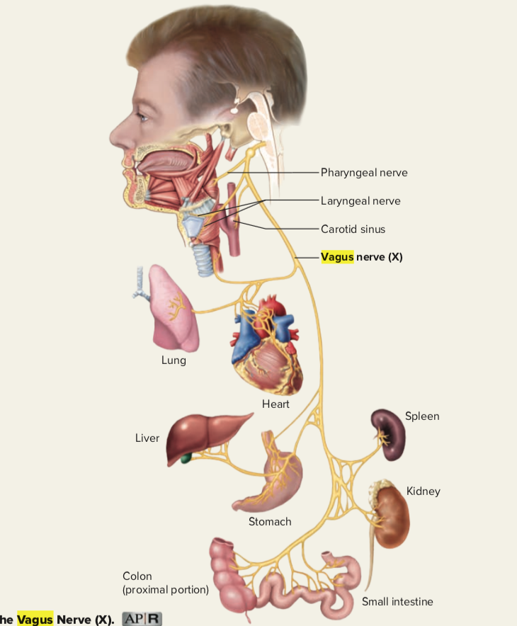
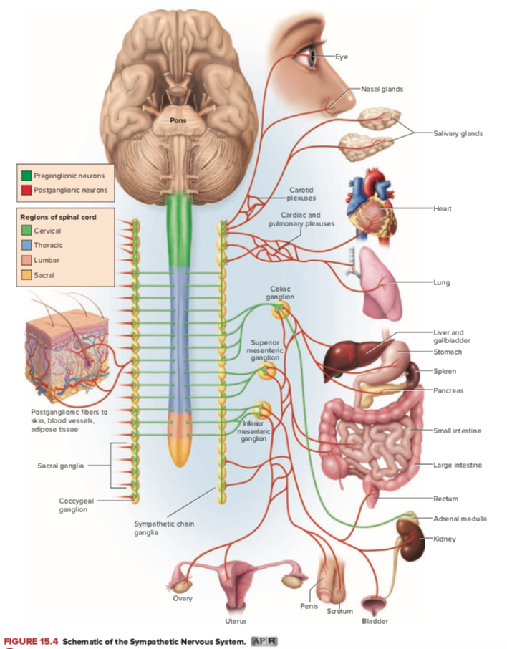
Innervation of the Stomach
Copyright © The McGraw-Hill Companies, Inc. Permission required for reproduction or display. Figure from: Saladin, Anatomy & Physiology, McGraw Hill, 2018

Slide 9
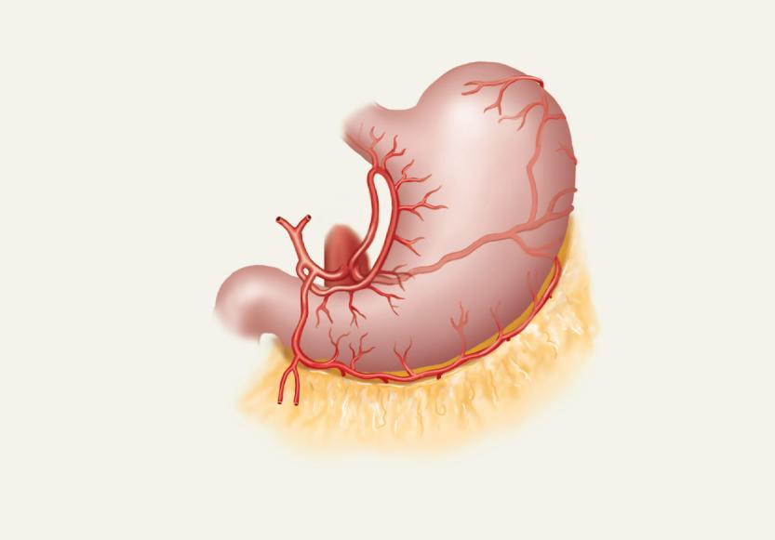
blood supply to the Stomach
Copyright © The McGraw-Hill Companies, Inc. Permission required for reproduction or display. Figure from: Saladin, Anatomy & Physiology, McGraw Hill, 2018
Left gastric a.
Short
gastric a.
Splenic a.
Right gastric a.
Gastroduodenal a.
Left gastro-
omental a.
Right gastro-
omental a.
(b) Celiac circulation to the stomach

Slide 10
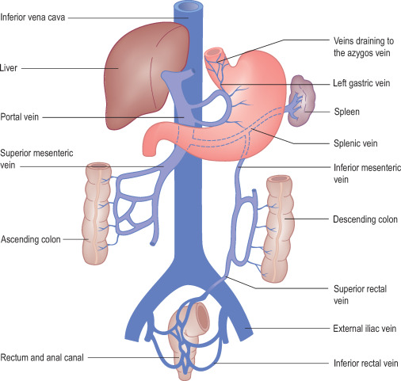
Circulation of the Stomach
Copyright © The McGraw-Hill Companies, Inc. Permission required for reproduction or display. Figure from: Saladin, Anatomy & Physiology, McGraw Hill, 2018

Slide 11
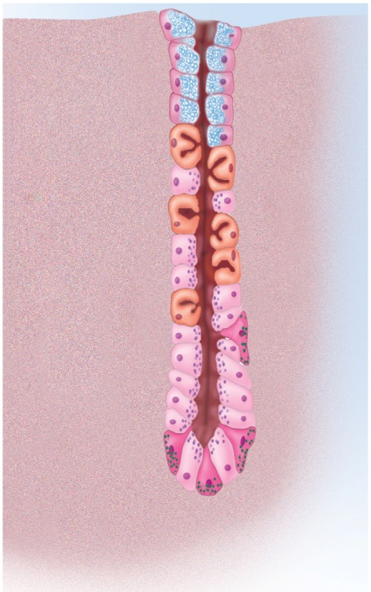
Cells of Gastric Glands
mucous cells – secrete mucus
  predominate in cardiac and pyloric glands
  in gastric glands, called mucous neck cells since they are concentrated at the neck of the gland
regenerative (stem) cells – found in the base of the pit and in the neck of the gland
  divide rapidly and produce a continual supply of new cells to replace cells that die
parietal cells – found mostly in the upper half of the gland
  secrete hydrochloric acid (HCl), intrinsic factor, and a hunger hormone called ghrelin
chief cells – most numerous
  secrete gastric lipase and pepsinogen
  dominate lower half of gastric glands
  absent in pyloric and cardiac glands
enteroendocrine cells – concentrated in lower end of gland
  secrete hormones and paracrine messengers that regulate digestion
Copyright © The McGraw-Hill Companies, Inc. Permission required for reproduction or display. Figure from: Saladin, Anatomy & Physiology, McGraw Hill, 2018
Mucous neck cell
Parietal cell
Chief cell
G cell
(c) Gastric gland
Figure 25.13c

Slide 12
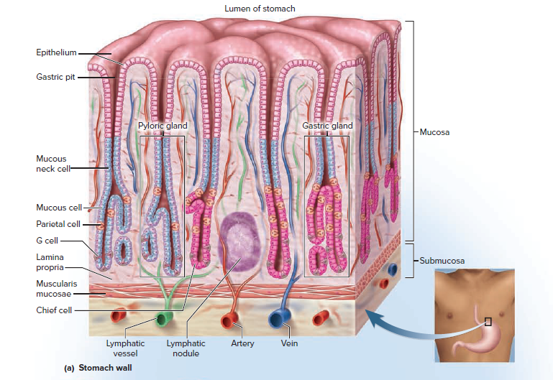
Mucosa of the Stomach Wall

Slide 13
Mini-Case #1 – Peptic Ulcer
Harold, a fifty-eight year old grocery store manager, had recently been waking up in the middle of the night with abdominal pain. This was happening several nights a week. He was also experiencing occasional discomfort in the middle of the afternoon. Harold decided to schedule an appointment with his physician.
The doctor listened as Harold described his symptoms and then asked Harold some questions. He noted that Harold's appetite had suffered as a result of the pain he was experiencing and as a result of the fear that what he was eating may be responsible for the pain. Otherwise, Harold seemed fine.

Slide 14
Mini-Case #1 – Peptic Ulcer
The doctor referred Harold to a physician that specialized in internal medicine and had Harold make an appointment for a procedure called an endoscopy. The endoscopy was performed at a hospital later that week. During the procedure, a long, thin tube was inserted into Harold's mouth and directed into his digestive tract. The end of the tube was equipped with a light source and a small camera which allowed the doctor to observe the interior of Harold's stomach. The endoscope was also equipped with a small claw-like structure that the doctor could use in order to obtain a small tissue sample from the lining of Harold's stomach, if required.
The endoscopy revealed that Harold had a peptic ulcer. Analysis of a tissue sample taken from the site showed that Harold also had an infection that was caused by Helicobacter pylori bacteria. The doctor who performed the endoscopy gave Harold prescriptions for two different antibiotics and a medication that would decrease the secretion of stomach acid. The doctor also instructed Harold to schedule an appointment for another endoscopy procedure in 6 months.

Slide 15
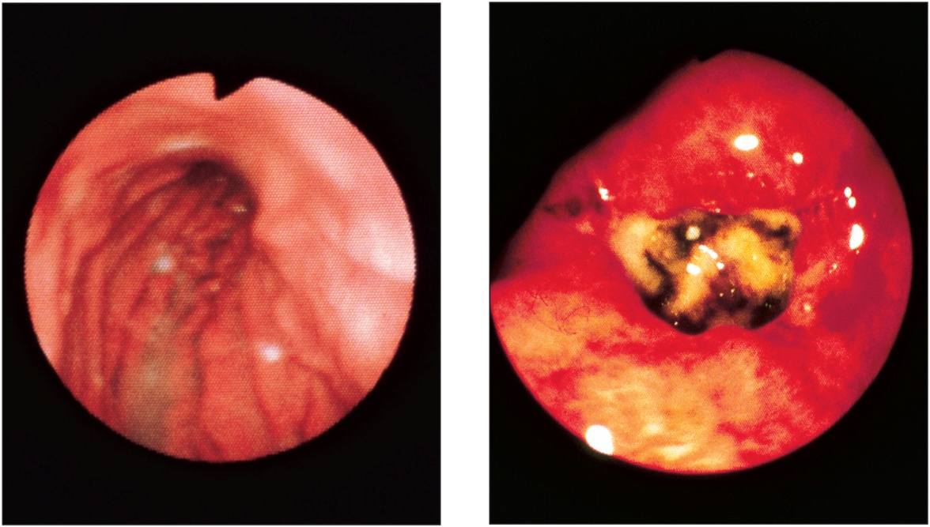
Healthy Mucosa and Peptic Ulcer
Copyright © The McGraw-Hill Companies, Inc. Permission required for reproduction or display. Figure from: Saladin, Anatomy & Physiology, McGraw Hill, 2018
Figure 25.16 a-b
acid-resistant bacteria -Helicobacter pylori.
(a) Normal
(b) Peptic ulcer
CNR/SPL/Photo Researchers, Inc.

Slide 16
Case Review
Questions
1. Describe the functions of the following components of gastric juice.
Hydrochloric acid
Pepsinogen
Pepsin
Intrinsic factor
Gastric Lipase
Chemical Messengers
Al-Farabi Kazakh National University
Higher School of Medicine

Slide 17
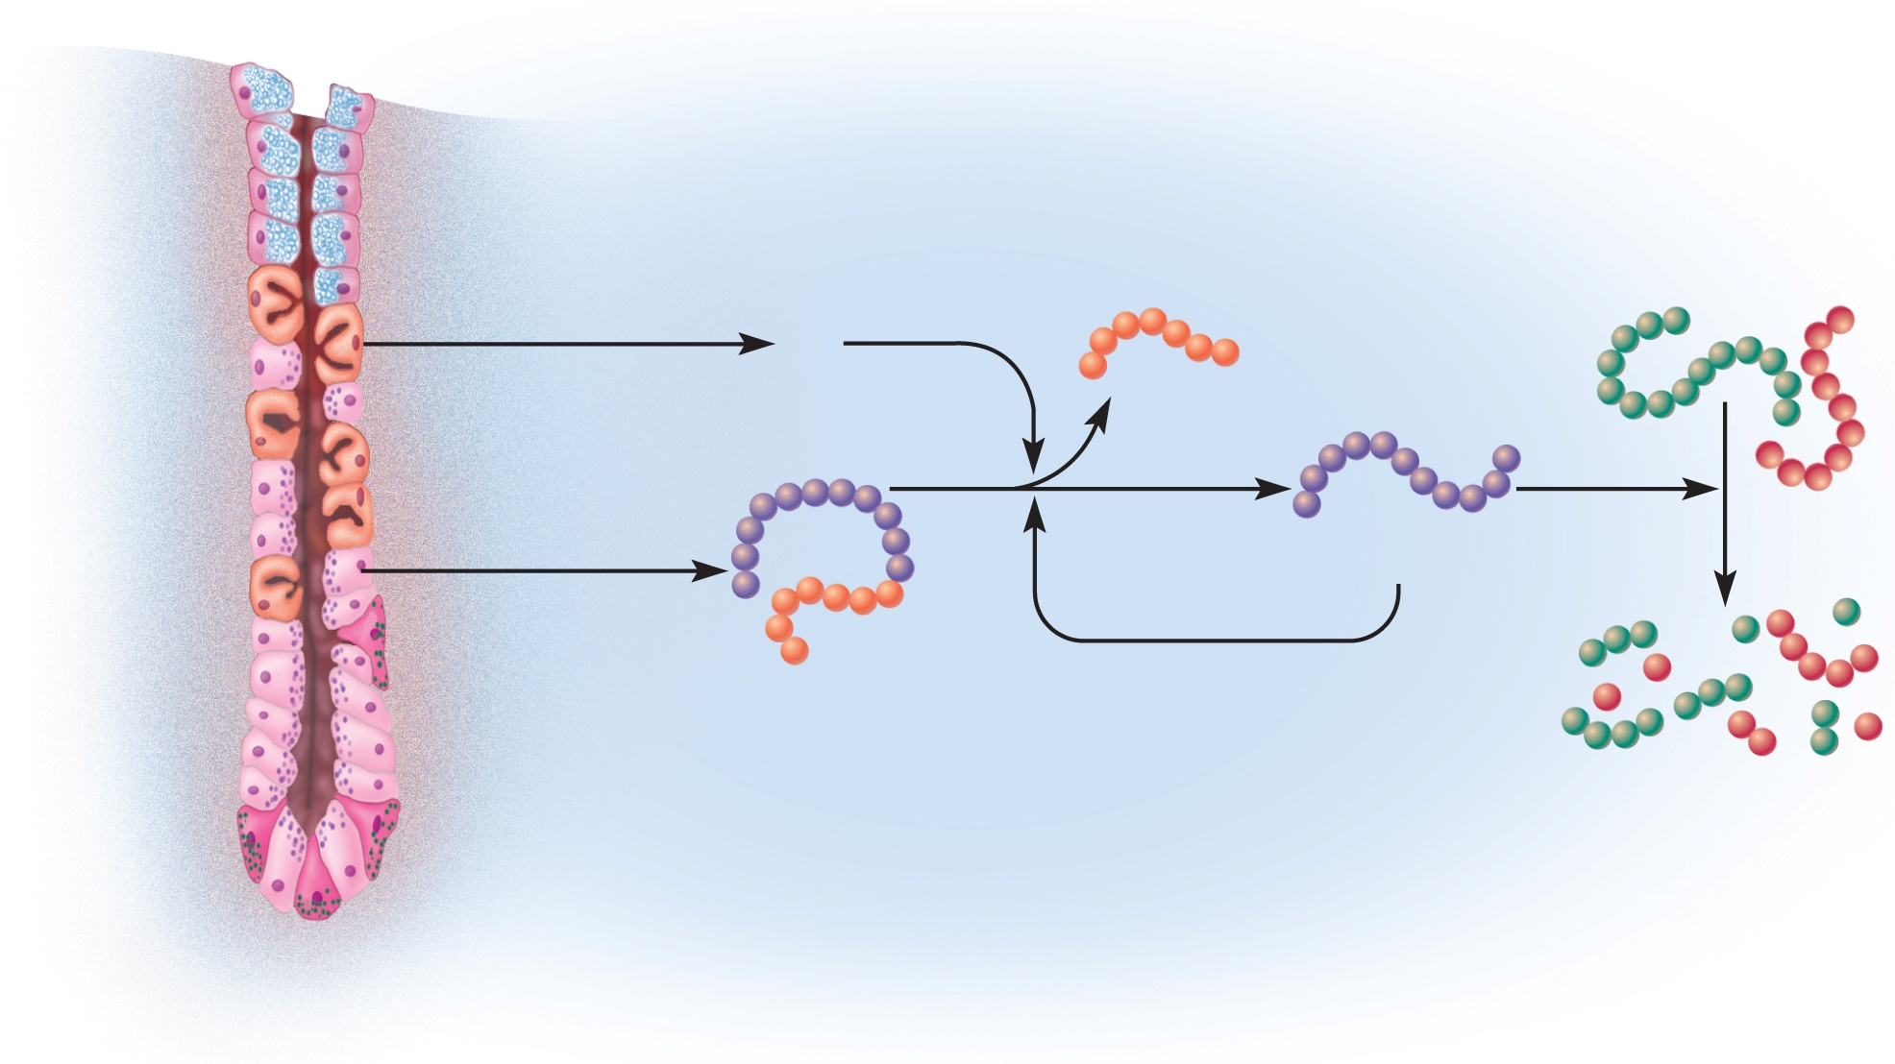
Production and Action of Pepsin
Copyright © The McGraw-Hill Companies, Inc. Permission required for reproduction or display. Figure from: Saladin, Anatomy & Physiology, McGraw Hill, 2018
Parietal cell
Removed
peptide
Dietary
proteins
HCl
Pepsin
(active enzyme)
Chief cell
Pepsinogen
(zymogen)
Partially digested
protein
Gastric gland
Figure 25.15

Slide 18
Gastric Motility
swallow food
mechanoreceptors in the pharynx
medulla oblongata.
the vagus nerves stomach.
receptive-relaxation response
a rhythm of peristaltic contractions controlled by pacemaker cells in longitudinal layer of muscularis external

Slide 19
Digestion and Absorption
salivary and gastric enzymes partially digest protein and lesser amounts of starch and fat in the stomach
most digestion and nearly all absorption occur after the chyme has passed into the small intestine
stomach does not absorb any significant amount of nutrients
  aspirin
  some lipid-soluble drugs

Slide 20
Case Review
Questions
2. Why don’t the components of gastric juice damage the wall of the stomach in the absence of a H. pylori infection?
Al-Farabi Kazakh National University
Higher School of Medicine

Slide 21
Case Review
Questions
3.Why don’t most other types of bacteria produce ulcers?
Al-Farabi Kazakh National University
Higher School of Medicine

Slide 22
Protection of the Stomach
living stomach is protected in three ways from the harsh acidic and enzymatic environment it creates
  mucous coat – thick, highly alkaline mucus resists action of acid and enzymes
  tight junctions - between epithelial cells prevent gastric juice from seeping between them and digesting the connective tissue of the lamina propria and beyond
  epithelial cell replacement – stomach epithelial cells live only 3 to 6 days
    sloughed off into the chyme and digested with the food
    replaced rapidly by cell division in the gastric pits

Slide 23
Regulation of Gastric Function
The nervous and endocrine systems
increase gastric secretion and motility when food is eaten
suppress as the stomach empties.
gastric activity is divided into three phases:
  cephalic phase – stomach being controlled by brain
  gastric phase – stomach controlling itself
  intestinal phase – stomach being controlled by small intestine

Slide 24
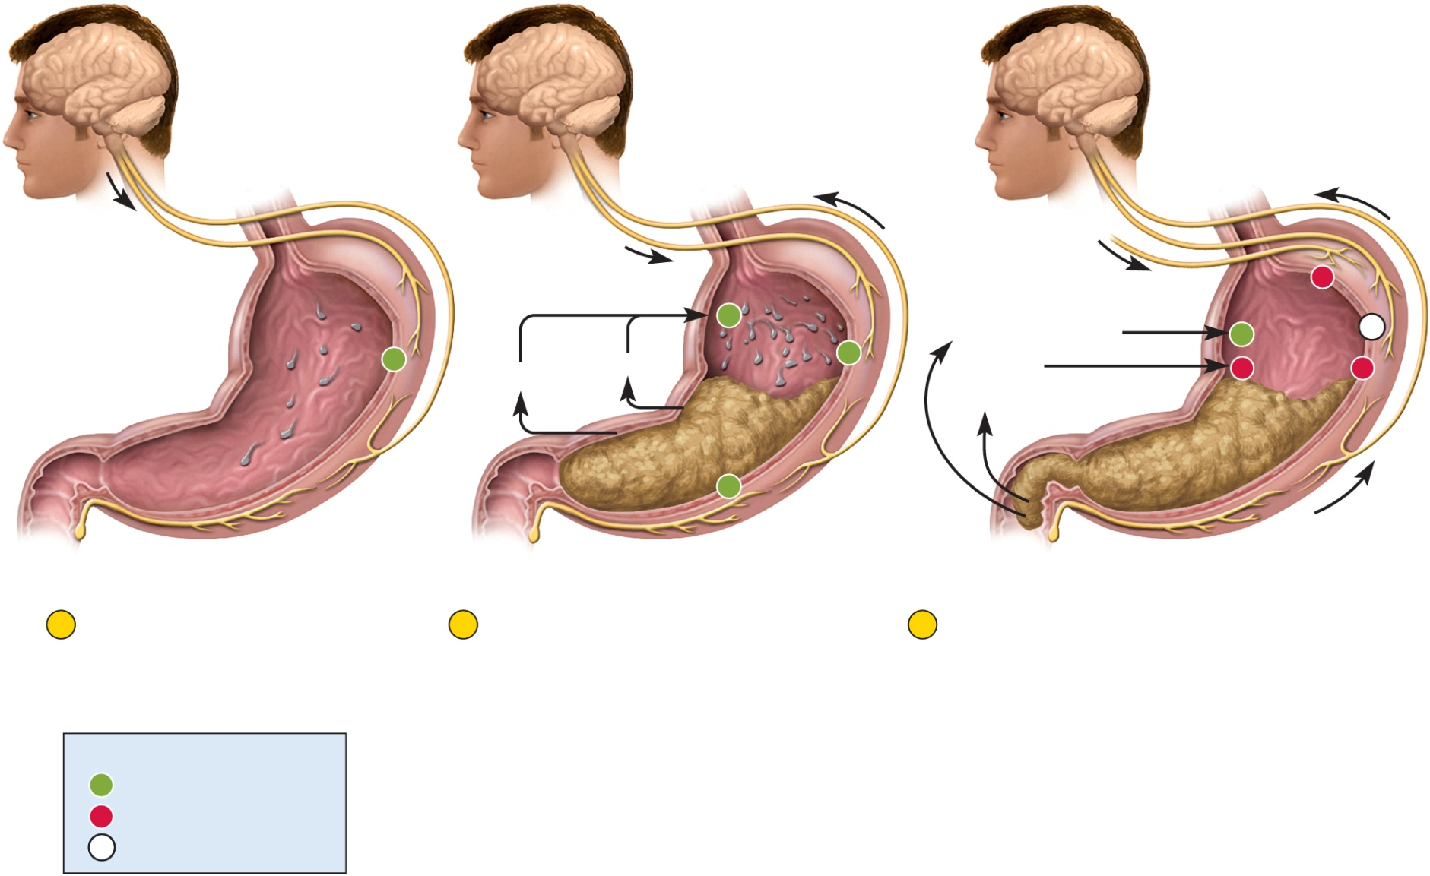
Regulation of Gastric Function
Copyright © The McGraw-Hill Companies, Inc. Permission required for reproduction or display. Figure from: Saladin, Anatomy & Physiology, McGraw Hill, 2018
Sensory and
mental input
Long (vagovagal) reflex:
Sensory fibers
Motor fibers
Vagus nerve
Vagus nerve
Vagus nerve
Sympathetic nerve
–
+
Intestinal gastrin
+
0
+
Histamine
+
Secretin
and CCK
–
–
Gastrin
+
Short
(myenteric)
reflex
Enterogastric
reflex
1
Cephalic phase
Vagus nerve stimulates
gastric secretion even
before food is swallowed.
2
Gastric phase
Food stretches the stomach and
activates myenteric and
vagovagal reflexes. These
reflexes stimulate gastric
secretion. Histamine and gastrin
also stimulate acid and enzyme
3
Intestinal phase
Intestinal gastrin briefly stimulates the
stomach, but then secretin, CCK, and the
enterogastric reflex inhibit gastric secretion
and motility while the duodenum processes
the chyme already in it. Sympathetic nerve
fibers suppress gastric activity, while vagal
(parasympathetic) stimulation of the
stomach is now inhibited.
Key
+
Stimulation
–
Inhibition
0
Reduced or no effect
Figure 25.17

Slide 25
Regulation of Gastric Function
cephalic phase
  stomach responds to site, smell, taste, or thought of food
  sensory and mental inputs converge on the hypothalamus
    relays signals to medulla oblongata
  vagus nerve fibers from medulla oblongata stimulate the enteric nervous system of stomach
    in turn, stimulates gastric secretion

Slide 26
Regulation of Gastric Function
gastric phase
  period in which swallowed food and semi-digested protein activates gastric activity
    two-thirds of gastric secretion occurs in this phase
  ingested food stimulates gastric activity in two ways:
    by stretching the stomach
      activates short reflex mediated through myenteric nerve plexus
      activates long reflex mediated through the vagus nerves and the brainstem
    by increasing the pH of its contents
  gastric secretion is stimulated by three chemicals:
    acetylcholine (ACh) – secreted by parasympathetic nerve fibers of both reflexes
    histamine – a paracrine secretion from enteroendocrine cells in the gastric glands
    gastrin – a hormone produced by the enteroendocrine G cells in pyloric glands

Slide 27
Regulation of Gastric Function
intestinal phase
  stage in which the duodenum responds to arriving chyme and moderates gastric activity through hormones and nervous reflexes
  duodenum initially enhances gastric secretion, but soon inhibits it
    stretching of the duodenum accentuates vagovagal reflex that stimulates the stomach
    peptides and amino acids in chyme stimulate G cells of the duodenum to secrete more gastrin which further stimulates the stomach

Slide 28
Regulation of Gastric Function
    enterogastric reflex – duodenum sends inhibitory signals to the stomach by way of the enteric nervous system and signals to the medulla oblongata - triggered by acid and semi-digested fats in the duodenum
      inhibits vagal nuclei – reducing vagal stimulation of the stomach
      stimulate sympathetic neurons – send inhibitory signals to the stomach
    chyme also stimulates duodenal enteroendocrine cells to release secretin and cholecystokinin
      they stimulate the pancreas and gall bladder
      also suppress gastric secretion
    pyloric sphincter contracts tightly to limit chyme entering duodenum
      gives duodenum time to work on chyme
    enteroendocrine cells also secrete glucose-dependent insulinotropic peptide (GIP) originally called gastrin-inhibiting peptide
      stimulates insulin secretion in preparation for processing nutrients about to be absorbed by the small intestine

Slide 29
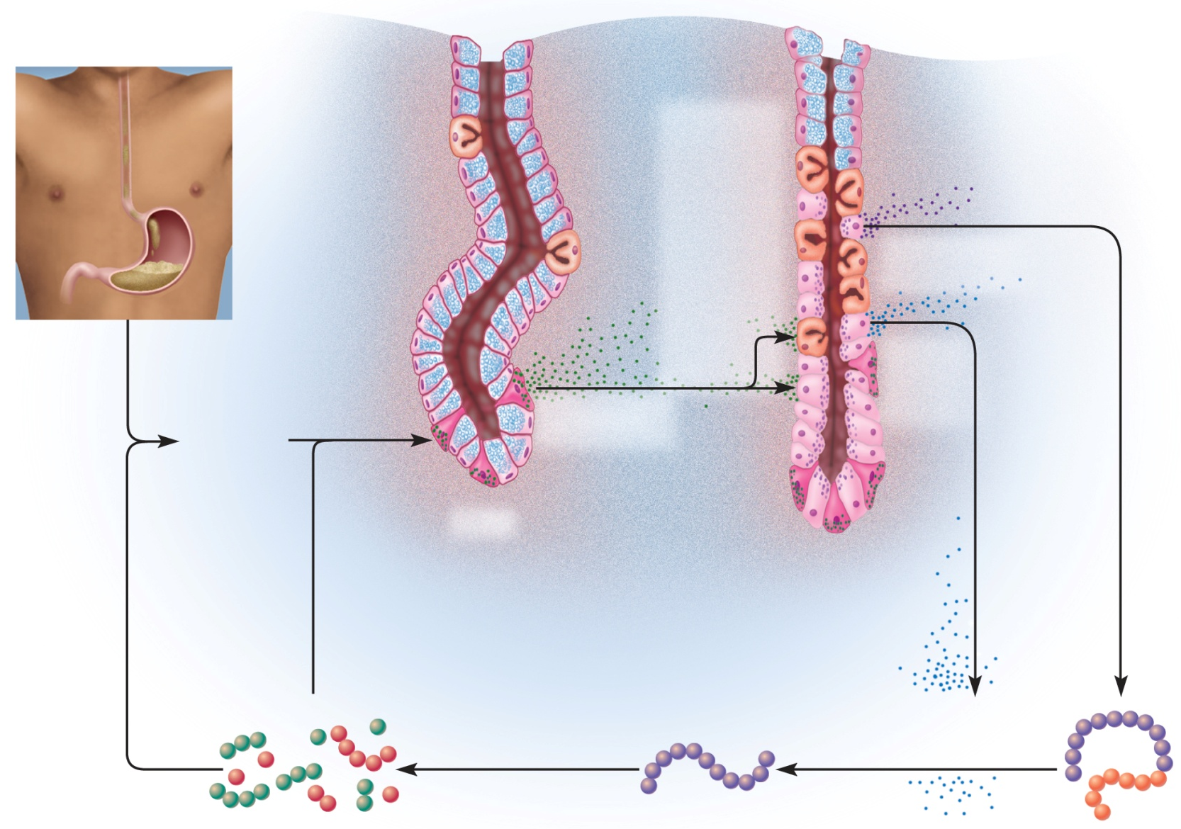
Positive Feedback Control- Gastric Secretion
Copyright © The McGraw-Hill Companies, Inc. Permission required for reproduction or display. Figure from: Saladin, Anatomy & Physiology, McGraw Hill, 2018
Pyloric gland
Gastric gland
Figure 25.18
Mucous cell
Parietal cell
Chief cell
Gastrin
stimulates
chief cells
and
parietal
cells
Chief cells secrete
pepsinogen
Ingested food
buffers
stomach acid
Parietal
cells
secrete
HCI
Elevated pH
stimulates
G cells
G cells secrete
gastrin
G cell
Oligopeptides
and amino
acids buffer
stomach acid
Oligopeptides
directly
stimulate
G cells
Pepsin digests
dietary protein
HCI converts
pepsinogen
to pepsin
Partially digested protein
Pepsin (active enzyme)
HCI
Pepsinogen
(zymogen)

Slide 30
Liver, Gallbladder, and Pancreas
small intestine receives chyme from stomach
also secretions from liver and pancreas
  enter digestive tract near the junction of stomach and small intestine
secretions are so important to the digestive process of the small intestine

Slide 31
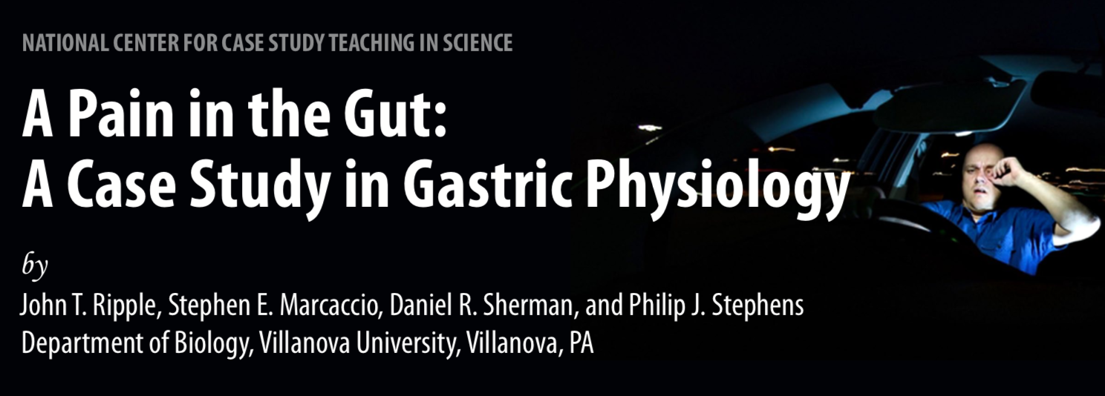
Frank was driving home after a long day at work. It was late and he was having problems driving in the dark with so much traffic. He was forced to take a detour and felt tired, so he took another sip of soda. “What would I do without sugar and caffeine?” he mumbled to himself.
Frank realized that he should probably stop the car as he noticed his hands begin to shake, but he continued anyway. Rounding a corner he realized that he was having trouble focusing on the road. He tried to blink away the blurriness and shook his head, but things did not change. In an instant, the car slipped off the road and hit a tree.
“What was that?” exclaimed Frank to the night air.

Slide 32
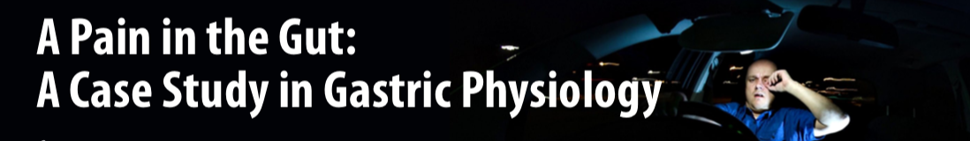
He quickly got out of the car and checked himself out. Other than the shock of the accident, Frank seemed to be okay. He pulled out his cell phone and called his wife, Stacey, to come pick him up. He then called to report the accident to the police and his insurance agent.
His wife arrived about an hour later and looked very concerned when she saw Frank sitting in the police car.
“Why aren’t you going to the hospital?” screamed Stacey. “Were you drinking again?” “I’m fine, and no I wasn’t drinking. Check with Sergeant Eversman if you don’t believe me. I lost focus; it’s been a long day and my vision’s a little off. This is too much stress. Please, I just want to go home.”
They drove home, but Stacey continued to badger Frank about going to the hospital.

Slide 33
Case Review
Questions
1. List Frank’s physical problems.
2. What do you think is causing Frank’s blurred vision?
3. With the above physical problems in mind, what do you speculate about Frank’s condition?
Al-Farabi Kazakh National University
Higher School of Medicine

Slide 34
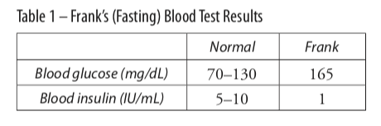
The nurse came in and gave the doctor the results of the blood tests.
“Is there something wrong?” asked Frank.
“Your blood glucose levels are above normal. Are you sure you didn’t eat or drink before the blood test this morning?” Frank shook his head.
“I am concerned because it’s been more than 12 hours since the accident and your blood glucose is elevated. I hate to think what it was after you ate the candy bars and drank all of that soda. Your body can convert excess glucose to sorbitol; you may have heard it referred to as sugar alcohol. Anyway, sorbitol accumulates in the lens of the eye, and this could explain your blurred vision because it draws water into the fibers of the lens and makes them swell. Since this changes the shape of the lens, it can affect your vision and in the long term it can even make the lens opaque and form a cataract.” ………

Slide 35
Case Review
Questions
1.What hormone is responsible for decreasing blood glucose levels? Which gland secretes this hormone?
Al-Farabi Kazakh National University
Higher School of Medicine

Slide 36
The Pancreas
spongy retroperitoneal gland posterior to the greater curvature of the stomach
12 to 15 cm long, and 2.5 cm thick
head encircled by duodenum, body, midportion, and a tail on the left
both an endocrine and exocrine gland
    endocrine portion – insulin and glucagon
    exocrine portion – pancreatic juice
Describe composition and digestive functions of pancreatic juice; the names and functions of its digestive zymogens and enzymes
Al-Farabi Kazakh National University
Higher School of Medicine

Slide 37
Pancreatic Zymogens
pancreatic zymogens
  trypsinogen
  chymotrypsinogen
  procarboxypeptidase
pancreatic enzymes
  pancreatic amylase
  pancreatic lipase
  ribonuclease and deoxyribonuclease
Al-Farabi Kazakh National University
Higher School of Medicine

Slide 38
The Pancreas
    secretory acini- release their secretion into small ducts that converge on the main pancreatic duct
  pancreatic duct runs lengthwise through the middle of the gland
      hepatopancreatic ampulla
      hepatopancreatic sphincter
  accessory pancreatic duct – smaller duct that branches from the main pancreatic duct
Describe structure of the pancreatic acini, the duct system, and its connection to the duodenum
Al-Farabi Kazakh National University
Higher School of Medicine

Slide 39
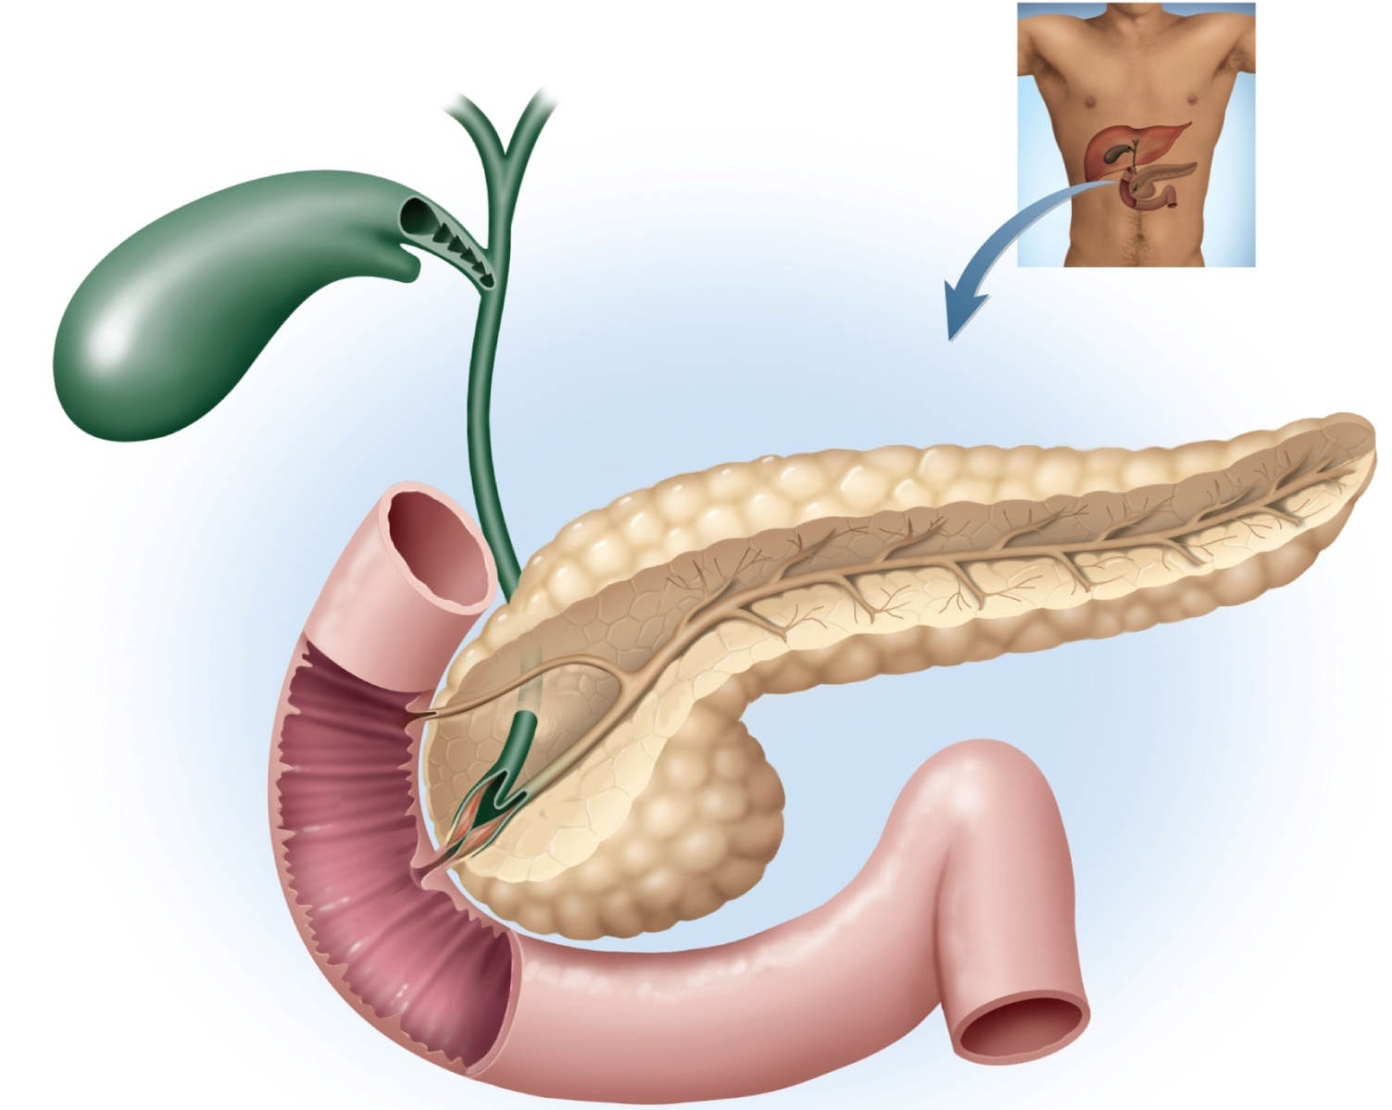
Gross Anatomy of the Gallbladder, Pancreas, and Bile Passages
Copyright © The McGraw-Hill Companies, Inc. Permission required for reproduction or display.
Figure from: Saladin, Anatomy & Physiology, McGraw Hill, 2018
Gallbladder:
Hepatic ducts
Neck
Body
Head
Common hepatic duct
Cystic duct
Bile duct
Accessory
pancreatic duct
Pancreatic duct
Duodenum
Minor duodenal
papilla
Pancreas:
Tail
Body
Circular folds
Head
Hepatopancreatic
sphincter
Duodenojejunal
flexure
Major duodenal
papilla
Hepatopancreatic
ampulla
Jejunum
Figure 25.21

Slide 40
Regulation of Secretion
three stimuli are chiefly responsible for the release of pancreatic juice and bile
  acetylcholine (ACh) - from vagus and enteric nerves
    stimulates acini to secrete their enzymes during the cephalic phase of gastric control even before food is swallowed
      enzymes remain in acini and ducts until chyme enters the duodenum
  cholecystokinin (CCK) - secreted by mucosa of duodenum in response to arrival of fats in small intestine
    stimulate pancreatic acini to secrete enzymes
    strongly stimulates gall bladder
    induces contractions of the gallbladder and relaxation of hepatopancreatic sphincter causing discharge of bile into the duodenum
  secretin - released from duodenum in response to acidic chyme arriving from the stomach
    stimulates ducts of both liver and pancreas to secrete more
    sodium bicarbonate
    raising pH to level pancreatic and intestinal digestive enzymes require

Slide 41
…Frank felt miserable. “I’m really not hungry. Maybe it was the change in diet, but I’ve had a persistent stomach ache and I didn’t eat much when I was away.
“Well, we need to take extra special care of you until we find out what’s wrong. I am sure everything’s going to be okay.” The next morning the alarm went off and Frank felt refreshed after a good night’s sleep.
“What’s the matter Stacey? You look like you’ve seen a ghost.”
Stacey brought him her pocket mirror so that he could see for himself. “Forget the glucose tolerance test. I think we need to go to the Emergency Room right now.”
Doctor Smithers looked into Frank’s eyes. “It’s a good thing you came in because even a first year medical student could see that you are jaundiced.”
Stacey looked concerned. “What does that mean? Is he going to be okay?”
“Well it could mean a few different things,” replied the doctor, “so we are going to have to run some tests to be sure.”

Slide 42
Case Review
Questions
1.What new physical signs or symptoms is Frank exhibiting?
2. What does the doctor see in Frank’s eyes that indicates jaundice? What molecule is responsible for Franks’ jaundiced appearance?
Al-Farabi Kazakh National University
Higher School of Medicine

Slide 43
Case Review
Questions
1.fill in Flow Chart 1 with the best choices from the provided word list.
2.Use Flow Chart 1 to suggest possible reasons for Frank’s jaundiced appearance.
3.Do you think that Frank’s jaundice is connected to the high blood glucose levels seen on the morning before his business trip? Why or why not?
4.Would you like to make a diagnosis to explain Frank’s jaundiced appearance? What tests would you run to determine or confirm any of your diagnoses?
Al-Farabi Kazakh National University
Higher School of Medicine

Slide 44
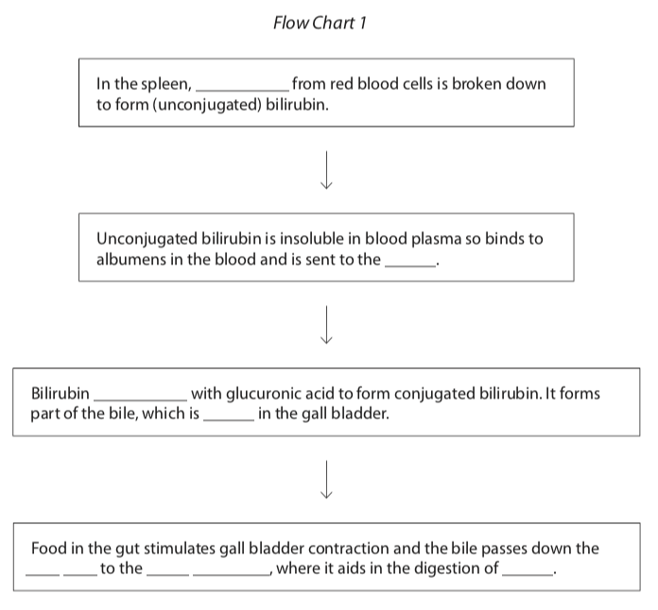
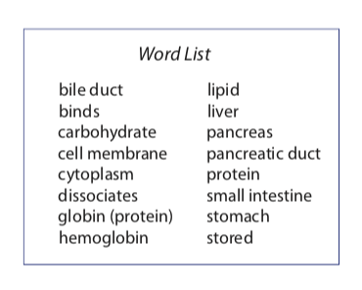
Case Review
Al-Farabi Kazakh National University
Higher School of Medicine

Slide 45
Gross Anatomy of Liver
four lobes - right, left, quadrate, and caudate
  falciform ligament separates left and right lobes
    sheet of mesentery that suspends the liver from the diaphragm
  round ligament (ligamentum teres) – fibrous remnant of umbilical vein
from inferior view, squarish quadrate lobe next to the gall bladder and a tail-like caudate lobe posterior to that
porta hepatis – irregular opening between these lobes
  point of entry for the hepatic portal vein and proper hepatic artery
  point of exit for the bile passages
  all travel in lesser omentum
gall bladder – between right and quadrate lobes
bare area on superior surface where it is attach to diaphragm

Slide 46
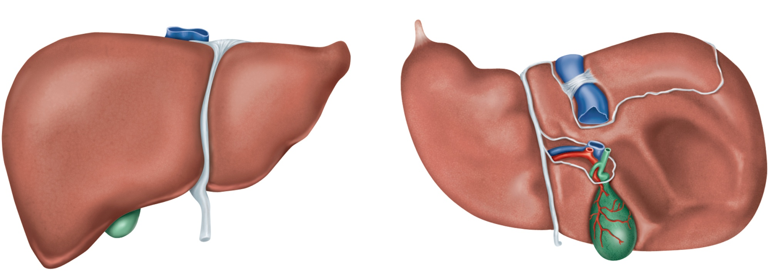
Gross Anatomy of Liver
Copyright © The McGraw-Hill Companies, Inc. Permission required for reproduction or display.
Figure from: Saladin, Anatomy & Physiology, McGraw Hill, 2018
Inferior vena cava
Bare area
Right lobe
Caudate lobe
Posterior
Left lobe
Falciform
ligament
Round ligament
Porta hepatis:
Hepatic portal vein
Proper hepatic artery
Common hepatic
duct
Anterior
Quadrate lobe
Gallbladder
Right lobe
(b) Anterior view
(c) Inferior view
Figure 25.19 b-c

Slide 47
Functions of Hepatocytes
after a meal, the hepatocytes absorb from the blood
  glucose, amino acids, iron, vitamins, and other nutrients for metabolism or storage
removes and degrades
  hormones, toxins, bile pigments, and drugs
secretes into the blood:
  albumin, lipoproteins, clotting factors, angiotensinogen, and other products
between meals, hepatocytes breaks down stored glycogen and releases glucose into the blood

Slide 48
Microscopic Anatomy of Liver
hepatic lobules are separated by a sparse connective tissue stroma
hepatic triad of two vessels and a bile ductule, visible in the triangular areas where three or more lobules meet
  small branch of proper hepatic artery
  small branch of the hepatic portal vein
    both supply blood to sinusoids which receive a mixture of nutrient-laden venous blood from the intestines, and freshly oxygenated arterial blood from the celiac trunk
    after filtering through the sinusoids, the blood is collected in the central vein
    ultimately flows into the right and left hepatic veins
    leave the liver at its superior surface and immediately drain into the inferior vena cava

Slide 49
Microscopic Anatomy of Liver
bile canaliculi
ductules of the triads
right and left hepatic ducts
common hepatic duct
cystic duct
bile duct
descends through lesser omentum toward the duodenum
bile duct joins the duct of the pancreas
hepatopancreatic ampulla
major duodenal papilla on duodenal wall
hepatopancreatic sphincter (sphincter of Oddi)

Slide 50
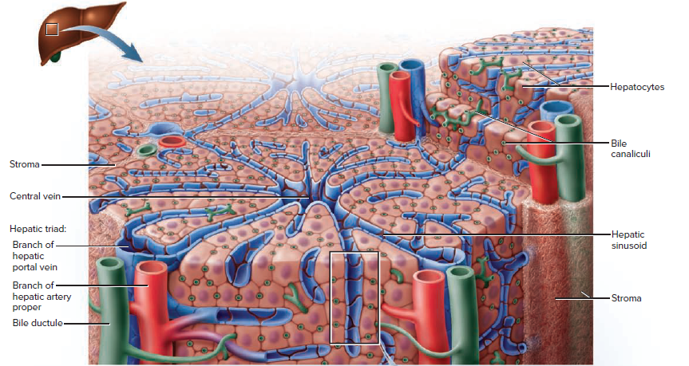
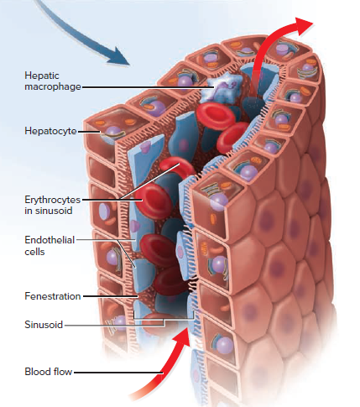

Slide 51
Gallbladder
gallbladder – a pear-shaped sac on underside of liver
  serves to store and concentrate bile by a factor of 20 by absorbing water and electrolytes
  about 10 cm long
  internally lined by highly folded mucosa with simple columnar epithelium
  head (fundus) usually projects slightly beyond inferior margin of liver
  neck (cervix) leads into the cystic duct

Slide 52
Bile
bile – yellow-green fluid containing minerals, cholesterol, neutral fats, phospholipids, bile pigments, and bile acids
  bilirubin – pigment from the decomposition of hemoglobin
  bacteria in large intestine metabolize bilirubin to urobilinogen
    responsible for the brown color of feces
  bile acids (bile salts) – steroids synthesized from cholesterol
    bile acids and lecithin, a phospholipid, aid in fat digestion and absorption
  gallstones may form if bile becomes excessively concentrated
  bile gets to the gallbladder by first filling the bile duct then overflowing into the gallbladder
  liver secretes about 500 – 1000 ml of bile daily
  80% of bile acids are reabsorbed in the ileum and returned to the liver
    hepatocytes absorb and resecrete them
    enterohepatic circulation – this route secretion, reabsorption, and resecretion of bile acids two or more times during digestion of an average meal
  20% of the bile acids are excreted in the feces
    this is the body’s only way of eliminating excess cholesterol
    liver synthesizes new bile acids from cholesterol to replace those lost in feces

Slide 53
“What does it mean to be jaundiced, doctor? Why did the whites of my eyes turn yellow?”
“It’s usually caused by a high level of a molecule called bilirubin in your blood, Frank.” “I was a biology major in college, but I don’t remember where bilirubin comes from.”
“Your blood has cells called erythrocytes or red blood cells; they contain hemoglobin which gives blood its red color. Cells in the spleen break down red blood cells and the products are reused by your body. The heme portion of hemoglobin is converted to bilirubin, which is the molecule that is responsible for your yellow color.”
“I remember now, isn’t bilirubin involved in digestion?”
“Yes. Bilirubin leaves the spleen in the blood and, because it’s not soluble in water, it binds with blood proteins called albumens to form unconjugated bilirubin. This bilirubin is taken up by the cells in the liver, where it combines with glucuronic acid to form conjugated bilirubin. It is one component of the bile, which travels down the bile duct to the gall bladder and the small intestine. When you eat, the gall bladder contracts and pushes the stored bile into the small intestine to aid in the digestion of fat.”
upper left quadrant of your abdomen ... sorry, around your stomach,” the doctor smiled at Frank and Stacey.

Slide 54
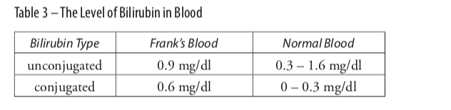
“So what do my tests show?”
“Your hematocrit and your liver enzymes are at normal levels.” “So, my liver’s okay?”
“These enzymes are normally confined to the liver cells and would only be found in large amounts in the blood if your liver was damaged. So these results indicate that there is no liver damage; that’s good. But I am concerned that there is tenderness in the upper left quadrant of your abdomen ... sorry, around your stomach,” the doctor smiled at Frank and Stacey.
“As I explained before, a jaundiced appearance is often produced by a buildup of bilirubin in the blood and your results confirm this (Table 3).”

Slide 55
“One more thing concerns me,” continued the doctor. “There is almost no urobilinogen or urobilin in your urine.”
“What are they?” asked Frank.
“Bacteria in your intestines change bilirubin to urobilinogen. This urobilinogen can be reabsorbed back into your body and some is converted to urobilin. These two molecules circulate in your blood and are excreted in your urine; it is the urobilin that produces the straw color of urine. The low level of these two molecules in your urine plus the high level of bilirubin in your blood and the pale color of your stools indicates to me that, for some reason, bilirubin is staying in your body instead of going into your intestines.”

Slide 56
Case Review
Questions
1.Where is unconjugated bilirubin formed?
2. Is the level of unconjugated bilirubin in Frank’s blood within the normal range?
3. Where is conjugated bilirubin formed?
4. Is the level of conjugated bilirubin in Frank’s blood within the normal range?
Al-Farabi Kazakh National University
Higher School of Medicine

Slide 57
Case Review
Questions
1.Where is unconjugated bilirubin formed?
2. Is the level of unconjugated bilirubin in Frank’s blood within the normal range?
3. Where is conjugated bilirubin formed?
4. Is the level of conjugated bilirubin in Frank’s blood within the normal range?
Using Flow Chart 1, outline some possible reasons for the high level of conjugated bilirubin; remember Frank’s liver enzymes are normal.
Al-Farabi Kazakh National University
Higher School of Medicine

Slide 58
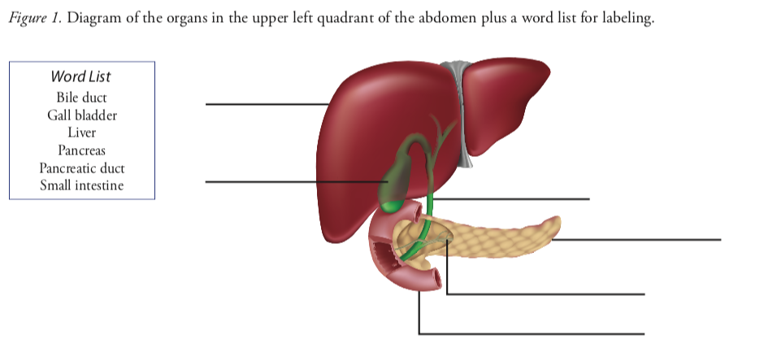
Case Review
Questions
1.Frank experienced tenderness in the upper left quadrant of his abdomen. Use the word list in Figure 1 to label the major organs in this area.
Al-Farabi Kazakh National University
Higher School of Medicine

Slide 59
Case Review
Questions
Consider your diagnosis for Frank’s high blood glucose levels. Which gland secretes insulin?
Which organs are involved in creating Frank’s jaundiced appearance?
Look at Figure 1 and determine whether this gland and these organs (answers to Questions 7 and 8) are connected in any way.
Can you think of a reason that would explain the high levels of glucose and conjugated bilirubin in Frank’s blood?
Would you like to make any adjustments to your diagnoses?
Al-Farabi Kazakh National University
Higher School of Medicine

Slide 60
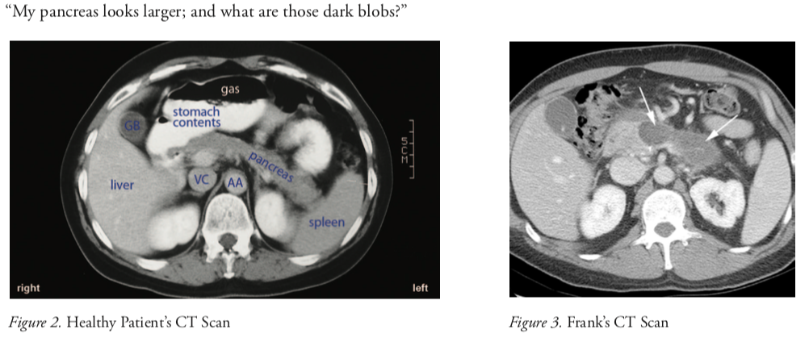

Slide 61
Case Review
Questions
Speculate on the identity of the “dark blobs” Frank noticed in Figure 3.
Do you think these “dark blobs” could affect the secretion of insulin?
Do you think these “dark blobs” could inhibit the liver from producing conjugated bilirubin?
Frank’s CT scan shows the “head” of the pancreas in the vicinity of the small intestine and the stomach. What do you think would be the effect of an enlarged pancreas on the ability of the gall bladder to send bile down the bile duct and into the small intestine?
Why does Frank have elevated levels of bilirubin in his blood?
Would you like to modify your diagnosis?
Al-Farabi Kazakh National University
Higher School of Medicine

Slide 62
Reference:
Saladin, Anatomy & Physiology, McGraw Hill, New York,2018
National center for case study teaching in science. https://sciencecases.lib.buffalo.edu/

